Slide 1
Margaret Hamilton
Lightning talk by Szilvi
23/08/2018

Slide 2
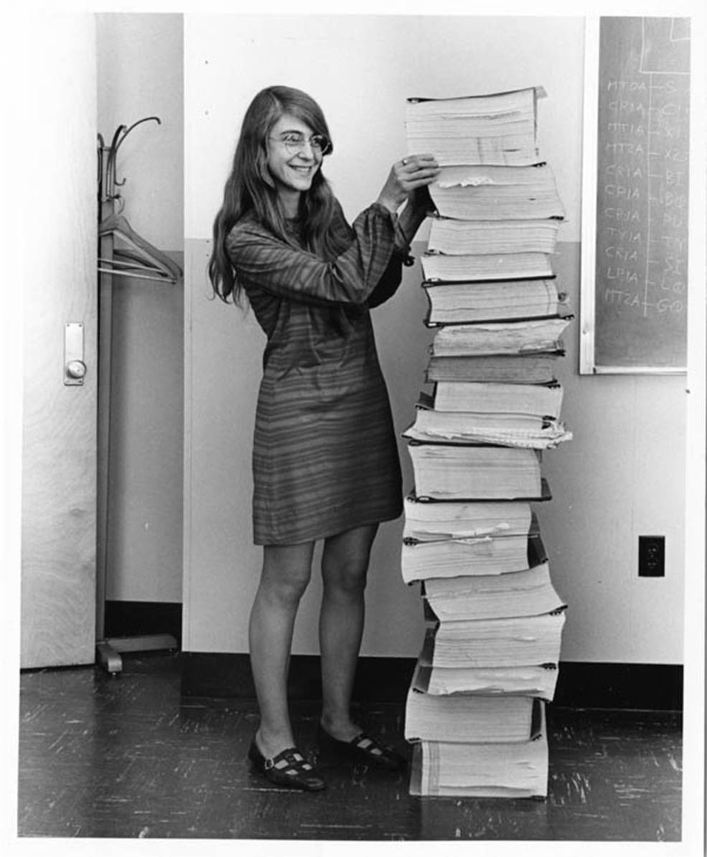
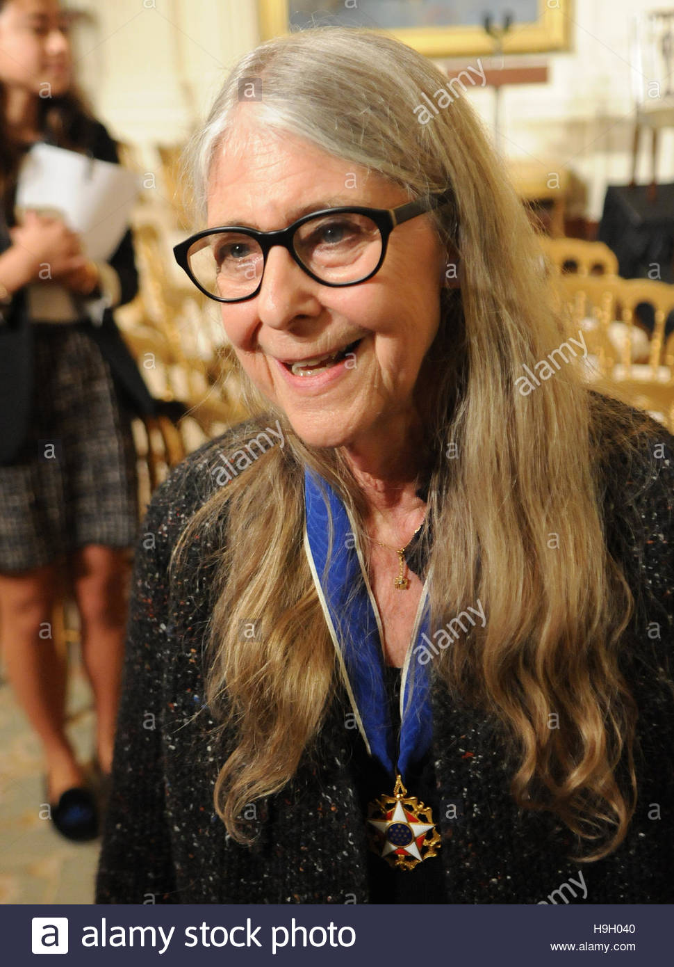
Notes:
Presidential medal of freedom

Slide 3
Mini bio
bachelor degree in mathematics
meteorology with Edward Lorenz
Semi-Automated Ground Environment
Americas Program for Orbital and Lunar Landing Operations
Notes:
US air force defense system

Slide 4
Mini bio
bachelor degree in mathematics
meteorology with Edward Lorenz
Semi-Automated Ground Environment
Americas Program for Orbital and Lunar Landing Operations
Notes:
US air force defense system

Slide 5
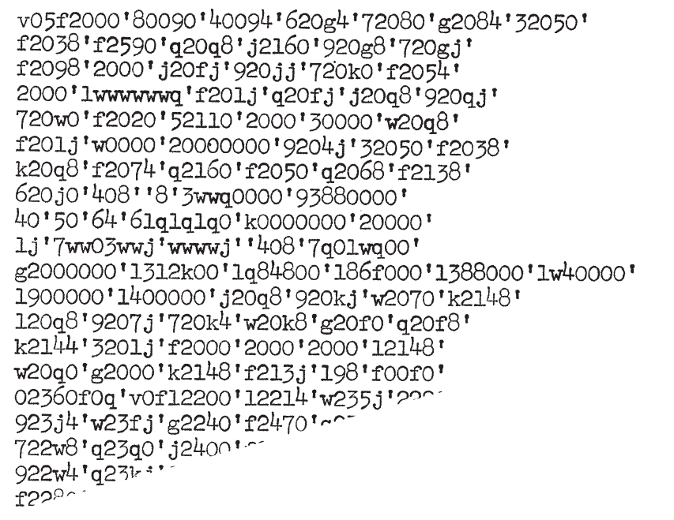
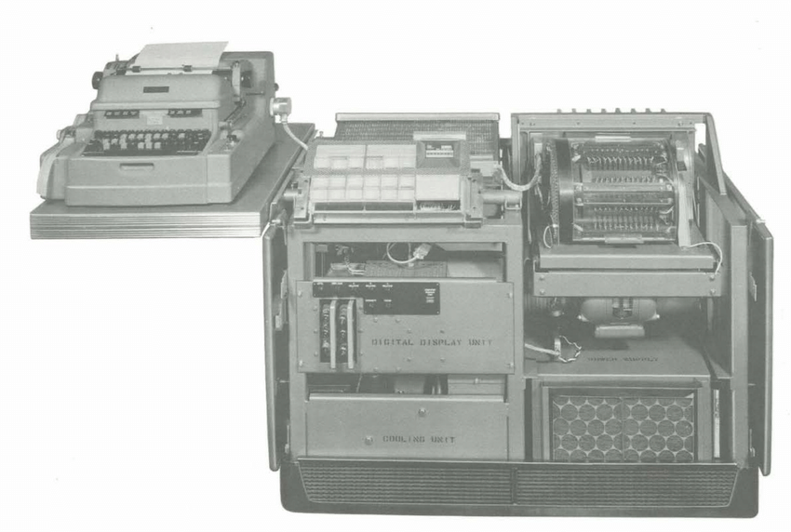
Librascope's General Purpose computer LGP-30
Notes:
does not need airconditioning, 360 kg
had no indexing for data

Slide 6
Mini bio
bachelor degree in mathematics
meteorology with Edward Lorenz
Semi-Automated Ground Environment (SAGE)
Americas Program for Orbital and Lunar Landing Operations
Notes:
US air force defense system

Slide 7
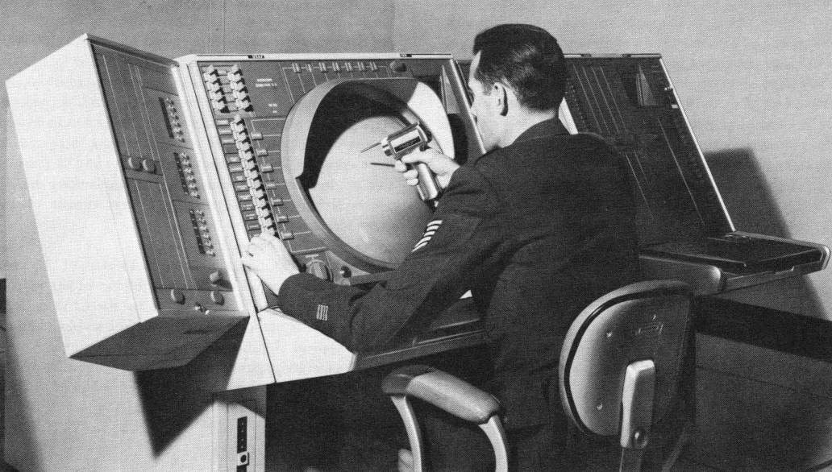
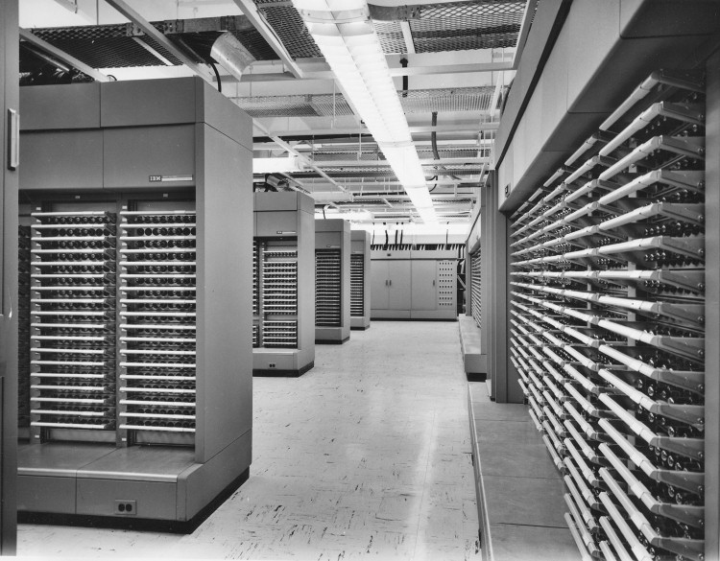
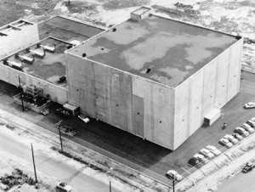
Semi Automated Ground Environment
AN/FSQ-7
Notes:
20+ sites
2000 m²
obselete in 1963

Slide 8
Mini bio
bachelor degree in mathematics
meteorology with Edward Lorenz
Semi-Automated Ground Environment
Americas Program for Orbital and Lunar Landing Operations
Notes:
AGC demoted to support, every main calculation received from Earth

Slide 9
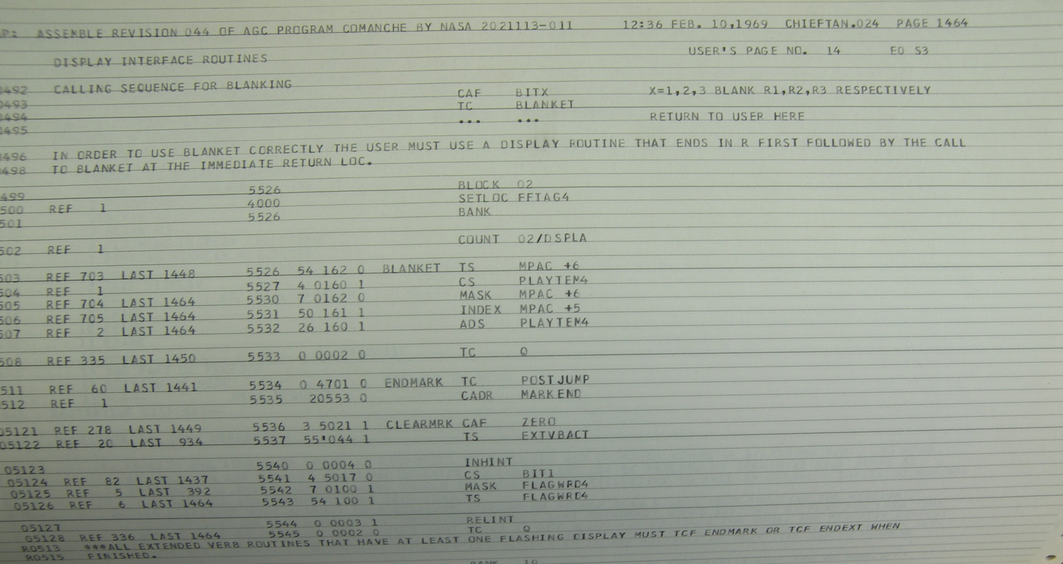

Slide 10
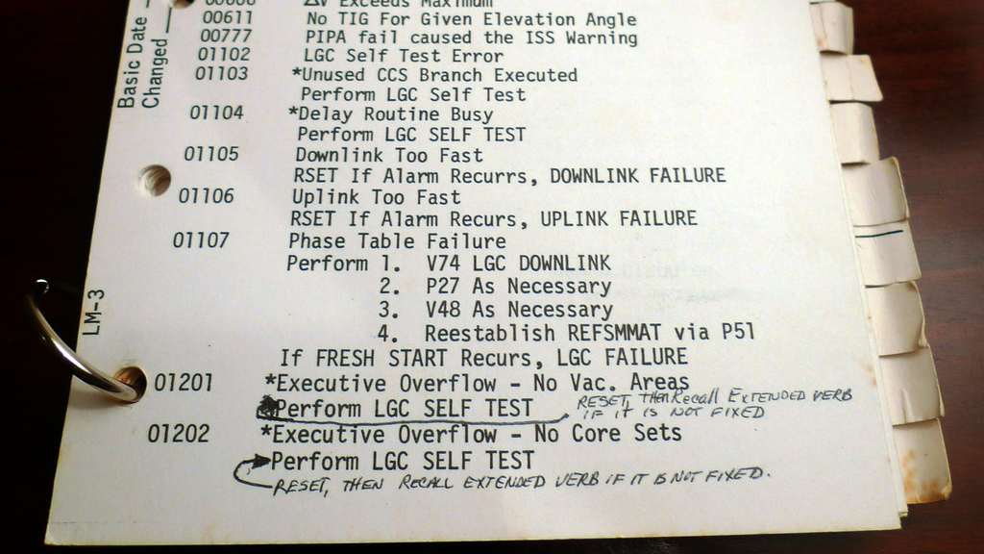
Notes:
Photo from Flickr by Eric Chaltron

Slide 11
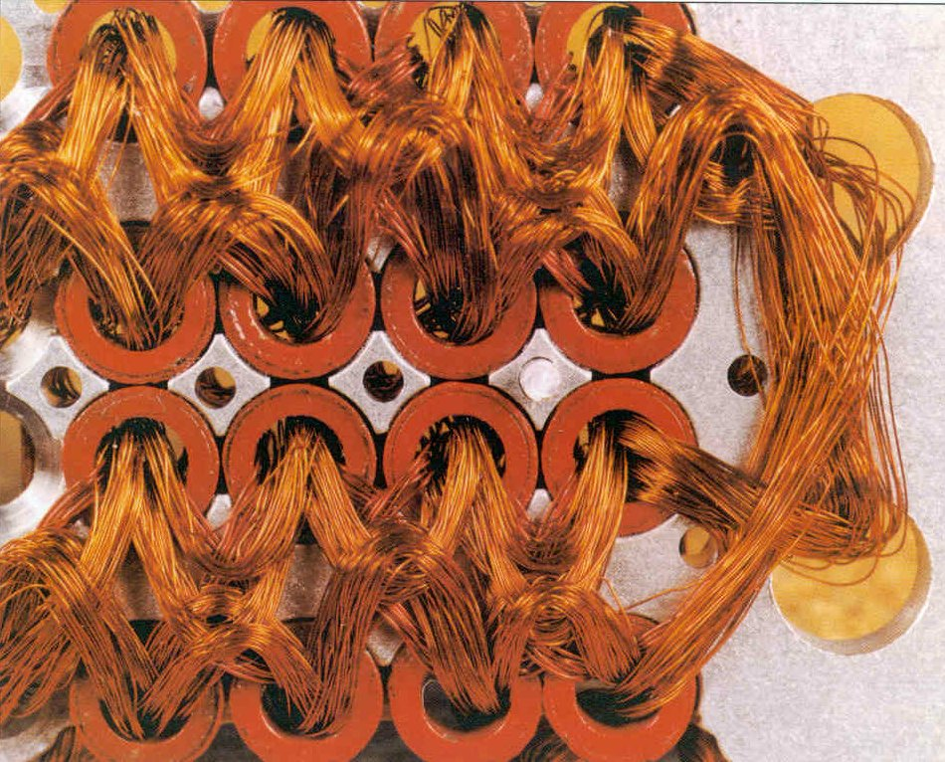
MIT Instrumentation Lab
Hal Laning
MAC – MIT Algebraic Compiler
Executive and waitlist operating system
Rope core memory
Notes:
there was no specification in the 1961 contract, what does the computer have to perform; 10 month prior finished program

Slide 12
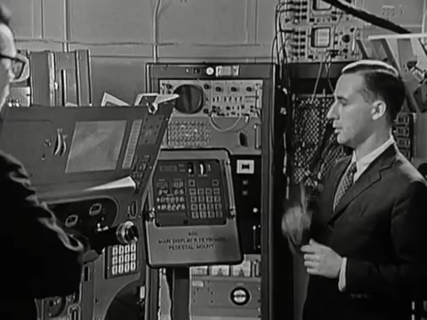
Notes:
https://www.youtube.com/watch?v=ndvmFlg1WmE

Slide 13
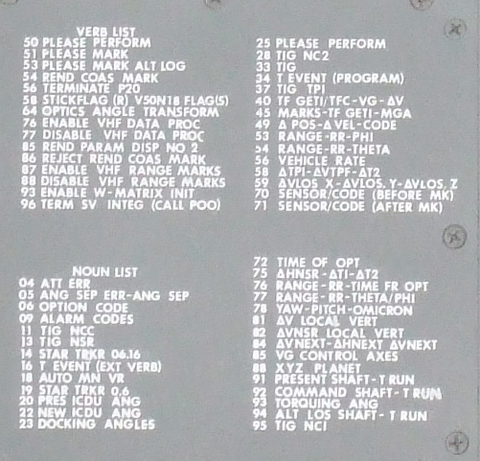

Slide 14
